Slide 1
In-hospital patient safety Hard evidence for reduced in-hospital and unexpected mortality by systematic use of Early Warning Scoring
Gitte Bunkenborg, ICRN, PhD
Head of Nursing Research
Notes:
Thank you for the opportunity to talk about the patient safety tool, the Early Warning Score, and about the evidence for reduced in-hospital and unexpected mortality when using EWS in the general ward setting.
During my presentation I will refer to a study conducted in collaboration between Lund University, Sweden and Hvidovre university hospital, Copenhagen, DENMARK

Slide 2
Patient safety Issues – ADVERSE EVENTS
Patients may be at risk of unexpected death during hospital stay due to poor clinical monitoring
The incidence of unexpected death:1.6-2.08/1000 admissions
The incidence of cardiac arrests:1.2/1000 admissions
Notes:
I would like you to imagine the general ward setting. The very serious adverse events that might take place here are: the cardiac arrest or unexpected death – found dead - or severe deterioration followed by transfer to the ICU

Slide 3
EARLY WARNING SCORE
EWS is a tool for the detection of deterioration. Evidence of its ability to predict cardiac arrest is strong, and more evidence in this area is on its way.
However, the effect on in-hospital mortality depends on how this tool is perceived and used by the interprofessional team responsible for the patient day and night, and how the EWS scores are interpreted together with clinical observations and knowledge of the individual patient.

Slide 4
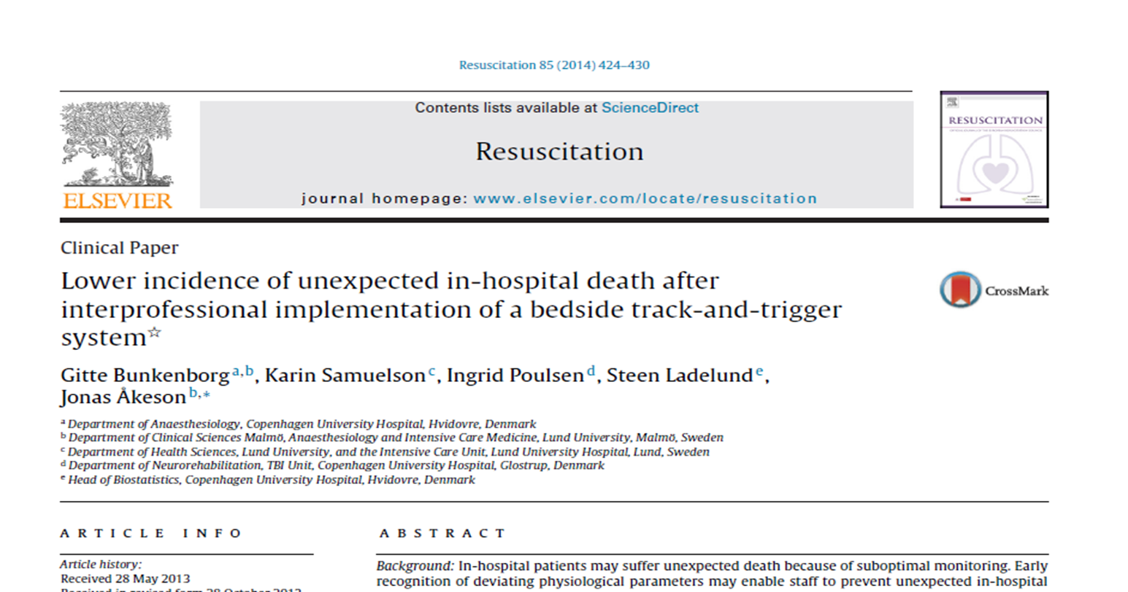
Conclusion
Systematic and interprofessional monitoring of general ward patients, based on early warning scoring, accompanied by teaching, training, and optimization of communication and collaboration, may significantly reduce unexpected in-hospital mortality

