Slide 1
Fibrinogen, haemostasis and postpartum haemorrhage
Ove Karlsson
Sahlgrenska University Hospital
Gothenburg, Sweden
Notes:
Thank you for giving me the opportunity ..

Slide 2
Bleeding during operation
2010 2016
1-2 L 8.1% 4.2%
>2 L 1.3% 0.76%
Better routine
Better cooperation
Better knowledge of haemostasis
Notes:
Notera att bild 1,5-2 men % sats är 1-2 liter. Tog ej med 1-1,5
Reduced with fifty percent

Slide 3
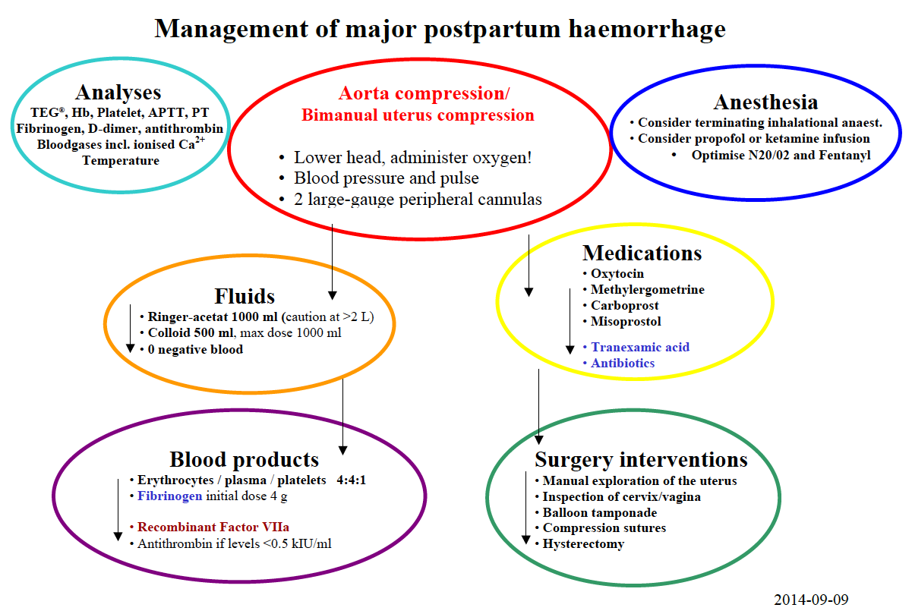
Aorta compression
Tranexamic acid
TEG/ROTEM
MEOWS
FIBRINOGEN
Repeat sampling
Communication
and teamwork
Blood/Plasma/Platelets 4/4/1

