Slide 1
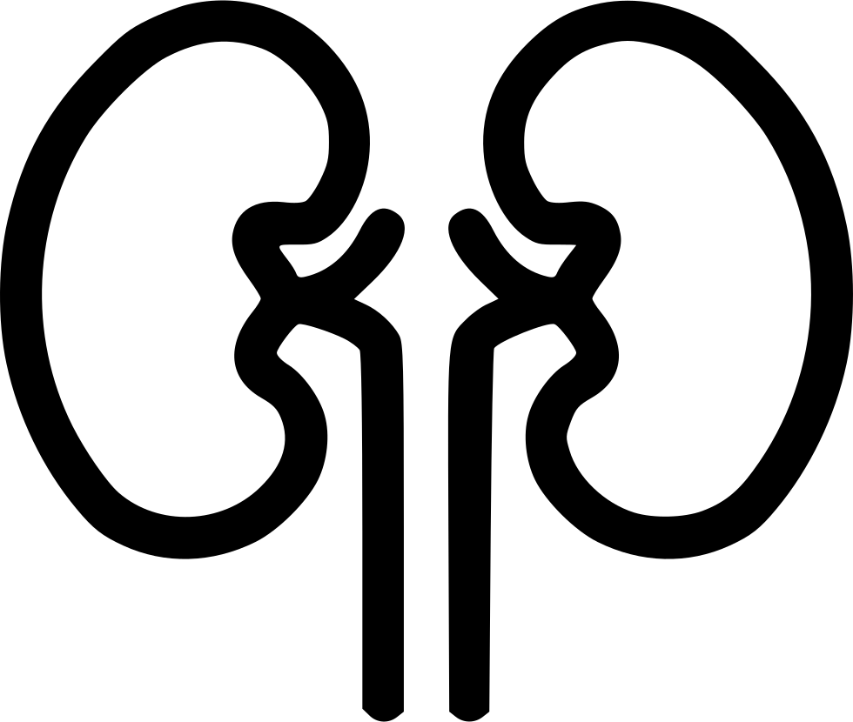
Long-term survival and morbidity after Acute Kidney Injury
Claire Stigare
Karolinska Sjukhuset Stockholm

Slide 2
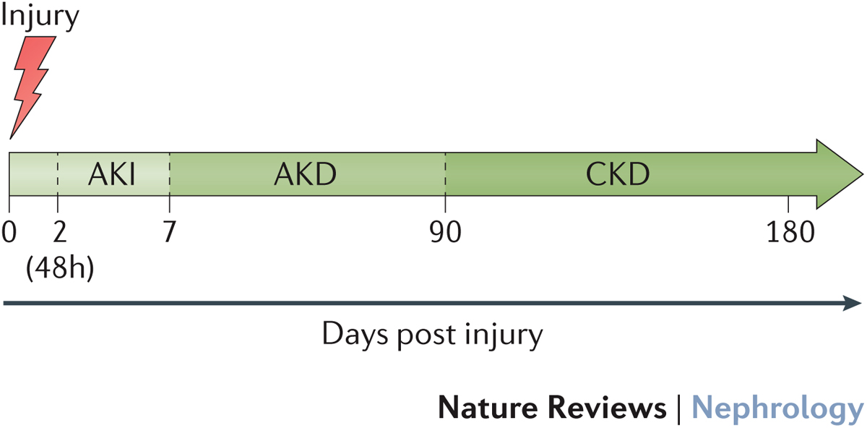
Acute Kidney Disease (AKD)
Damage/ loss of function 7 - 90 days after AKI. Grade change from baseline Creatinine.
Chronic Kidney Disease.(CKD)
Structural /functional abnormality lasting
> 90 days. GFR <60ml/min/1.73m²
End Stage Renal Disease (ESRD)
Advanced CKD (grade 5),
GFR< 15ml/min/1.73m^{2,}
or dialysis or transplant
Chawla, L. S. et al. (2017) (ADQI).

Slide 3
Long-term risk of remote organs dysfunction associated with AKI

Slide 4
Summary long-term outcome after AKI
70 year old lady, pneumonia, sepsis & AKI.
Alive one year? five years?
≈ 50% at one year ≈30% at 5 years
Will we know what her renal function is?
Few patients are followed-up
Chances of CKD or ESRD?
>30% risk of CKD >4% risk of ESRD at 5 years
Increase long-term risk of other organ dysfunctions?
Yes!

