Slide 1
Post-discharge issues in out-patient surgery – J.RAEDER
Pain
Nausea and vomiting
Fatigue
Cogn. Dysfunction, Delirium
Orthostatic hypotention
Sleep disorders
Surgical Complications
We should prepare our patients:
What we do in the hospital
What we plan for discharge
Patient and/or relative information
Oral
Written
Web cites

Slide 2
Post Discharge Nausea and Vomiting PDNV
Prophylaxis/treatment:
Non-opioid analgesia post-operatively
Residual effect of hospital given anti-emetics:
5-HT3 block, neuroleptic, ephedrine → up to 24 hr
Aprepitant, Palonosetron → 48 hrs
Dexamethasone, scopolamine patch → up 2-3 days
Non-pharmaocological measures:
Adjust fluid, food intake: timing – amount
Resting, fresh air, cold forehead dressing, acupressure
Drugs taken at home:
Tablets? Mixtures?
Orally disintergrating ondansetron
Suppositories (neuroleptics, metoclopramide)
Raeder J: ASA refresher course, 2017 – in press

Slide 3
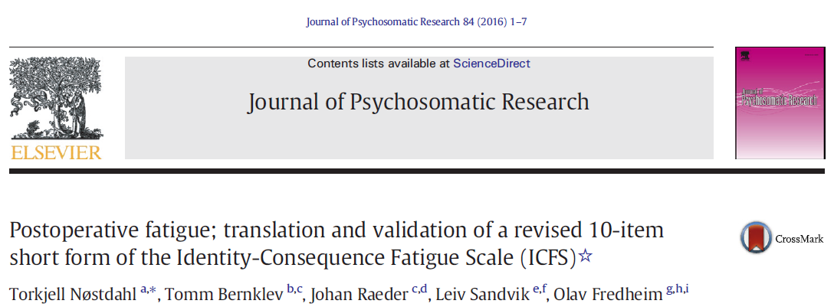
Fatigue Assessment in a Surgical Population
Identity-Consequences Fatigue Scale (ICFS)¹
Specifically developed for postoperative fatigue
31 items
ICFS 10-ShortForm (10-SF)²
10 items
Retains 98% of information in original ICFS
Christensen Fatigue Scale³
Single-item scale
NRS (1-10) with 4 anchors
Paddison J: J.Psycosom.Res. 2006
Nostdal T: J.Psycosom.Res. 2016
Christensen T: Br.J.Surg. 1982
Notes:
What is available for a proper assessment in the surgical population?
Even simpler, perhaps too simple; christensen
Typically favoured by surgeons…

Slide 4
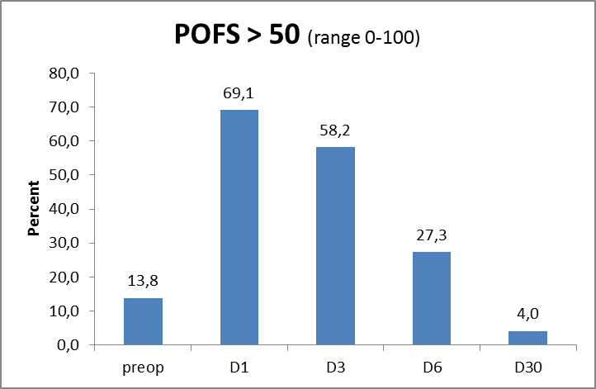
Post-operative fatigue
Day 1 Day 3 Day 6 day 30
POFS > 50 ≈ patient feel a significant «impact» on activities

Slide 5
Orthostatic hypotention
«Traditional» fainting:
Dehydration, pain, drugs (clonidine, pregabalin, gabapentin)
Postoperative Orthostatic Tolerance
In 12-60% of patients, more with extensive surgery, females,opioids, regular antihypertensive medication
Resolves within 24-48 hrs
Pathophysiology (tissue destruction? Inflammation?):
Attenuated endogenous vasopressor response,
increased vagal output
- Testing? Subcutaneous ephedrine?

Slide 6
Sleep Disorders
Low quality sleep first night
Disturbed day-night rythme, less REM sleep (opioids)
Increased day-time sleep
Night 2-3: «catch-up» sleep with more REM sleep, dreams, movements (hypoxia?)

