Slide 1
How to evaluate patients with OSA postoperatively
TAke-Home points from
identifying patients with or at risk for OSA prior to surgery is recommended
risk-stratification with tools like STOP-BANG yields low specificity and therefore low positive predictive value
adding a standardised protocol for evaluation of symptoms after surgery is a safe and resource-efficient way of deciding the right level of post-operative care

Slide 2
How to evaluate patients with OSA postoperatively
TAke-Home points from
this study from the Mayo-clinic provided the template for the protocol we implemented at the University Hospital in Örebro
we now use it for patients diagnosed with or at high risk for severe OSA when schedule for minor or intermediate surgery
Anesthesiology 2009; 110:869–77
Identification of Patients at Risk for Postoperative
Respiratory Complications Using a Preoperative
Obstructive Sleep Apnea Screening Tool and Postanesthesia
Care Assessment
Bhargavi Gali, M.D.,* Francis X. Whalen, M.D.,* Darrell R. Schroeder, M.S., † Peter C. Gay, M.D.,‡ David J. Plevak, M.D.§

Slide 3
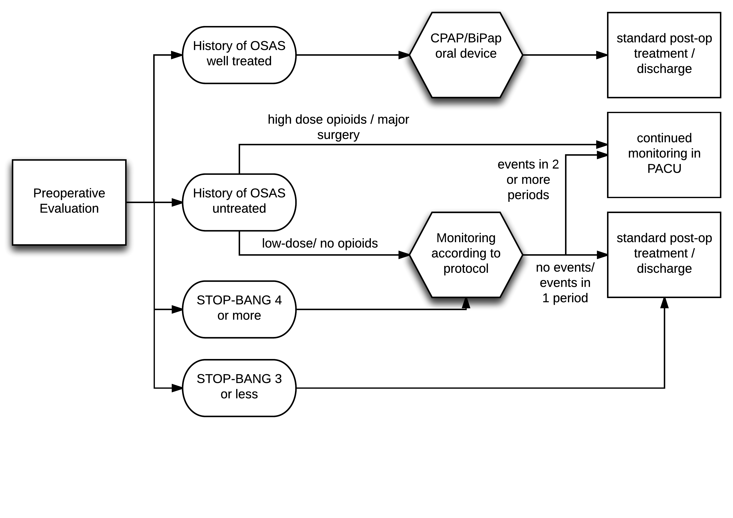
How to evaluate patients with OSA postoperatively
TAke-Home points from
the checklist and our patient flow in its current form.
should you wish to use them or collaborate on the matter please contact:
stephan.schwager@regionorebrolan.se

